Slide 1

G2M Case Study
Virtual Internship LISUM12
G2M Insight for Cab Investment Firm – Week 3
August 21st 2022

Slide 2
Executive Summary – G2M (Cab Industry) Case Study
XYZ is a private equity firm in US. Due to remarkable growth in the Cab Industry in last few years and multiple key players in the market, it is planning for an investment in Cab industry.
Objective : Provide actionable insights to help XYZ firm in identifying the right company for making investment.
The analysis has been divided into four sections:
Defining the problem
Understanding and collecting data
Using the data to find the most profitable cab company
My recommendations for investing

Slide 3
Data Exploration
20 Features (including 2 derived features)
Timeframe of the data: 01-31-2016 to 12-31-2018
Conclusions:
The data needed to be cleaned and combined before performing EDA. This was mainly matching the Transaction ID to the transaction.
The profit of rides was calculated (Profit) keeping other factors constant and only Price Charged and Cost of Trip features used to calculate profit.
The ratio of population and users in any given city (Ratio) was calculated by dividing Population by Users.
The Users feature of City.csv dataset is treated as number of cab users in the city. We have assumed that this can be other cab users as well (including Yellow and Pink cab).
Cab_Data.csv
Customer_ID.csv
Transaction_ID.csv
City.csv
cab_dataframe.csv

Slide 4
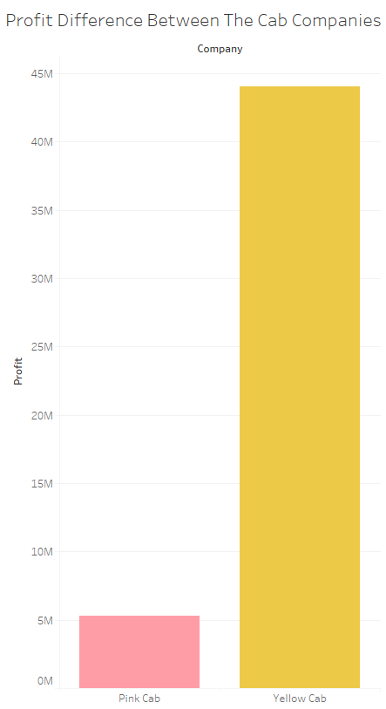
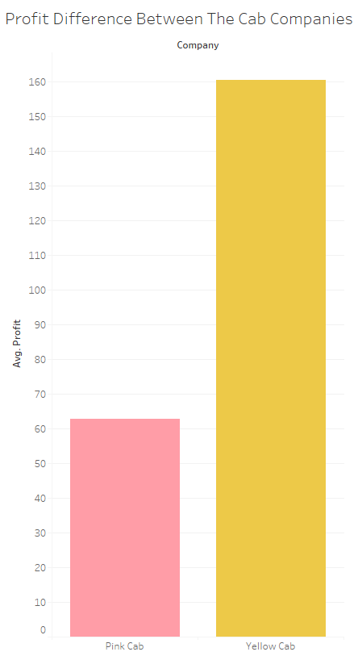
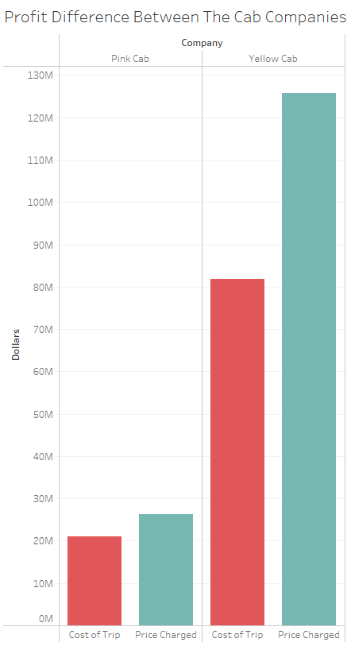
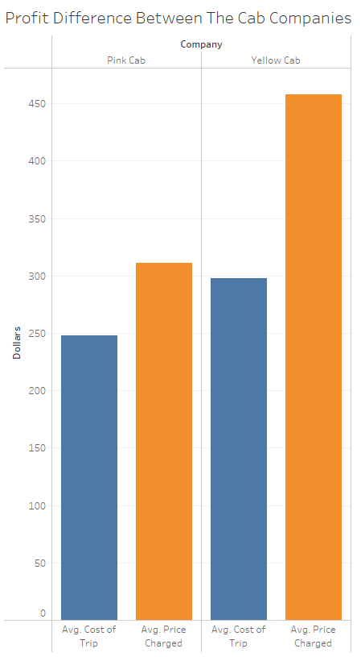
Profit Analysis
Profit Analysis
The Yellow Cab Company makes more total profit and more average profit per transaction than the Pink Cab Company does. This is due to a greater charge price and average charge price. So far Yellow Cab Company seems like a smarter investment.

Slide 5
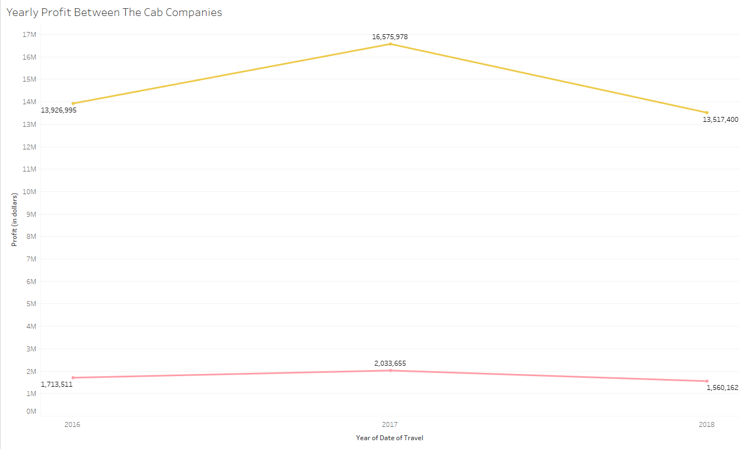
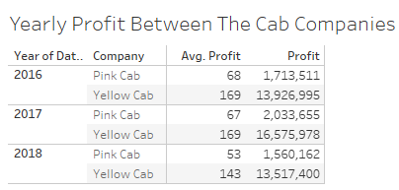


Profit Analysis By Year
The Yellow Cab Company makes significantly more profit than the Pink Cab Company per year, on average. Their prices seem to fluctuate at the same rate year to year as well.

Slide 6
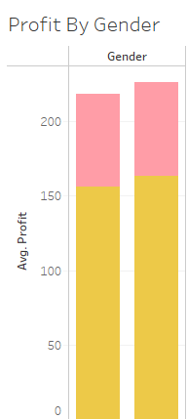
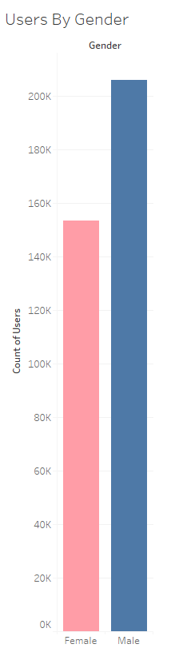
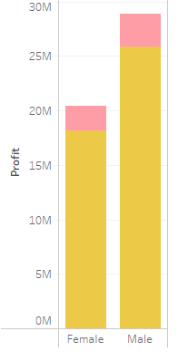

Profit Analysis By Gender
Men use the cab companies’ services more than women, however, there are no significant differences in the profit margins per transaction by gender.

Slide 7
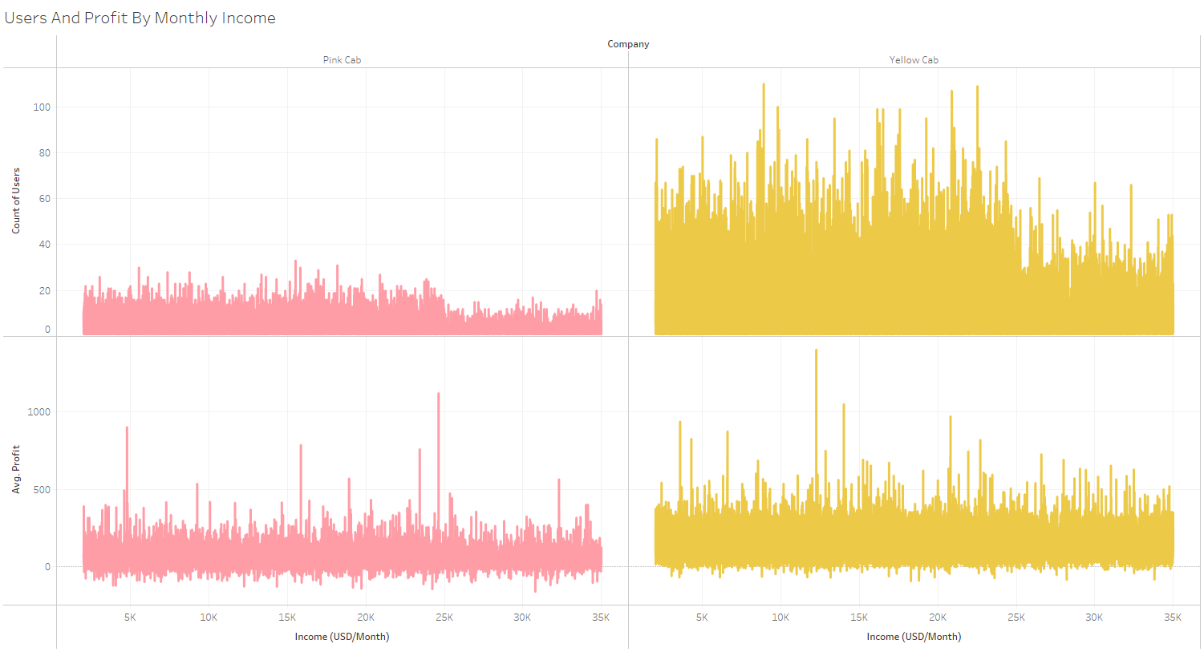
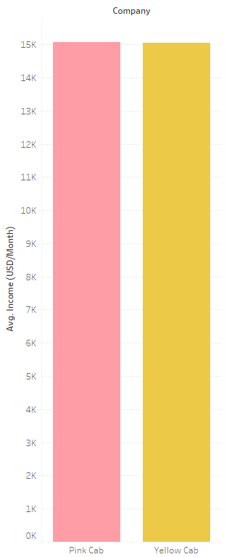
Users And Profit Analysis By Monthly Income

Slide 8
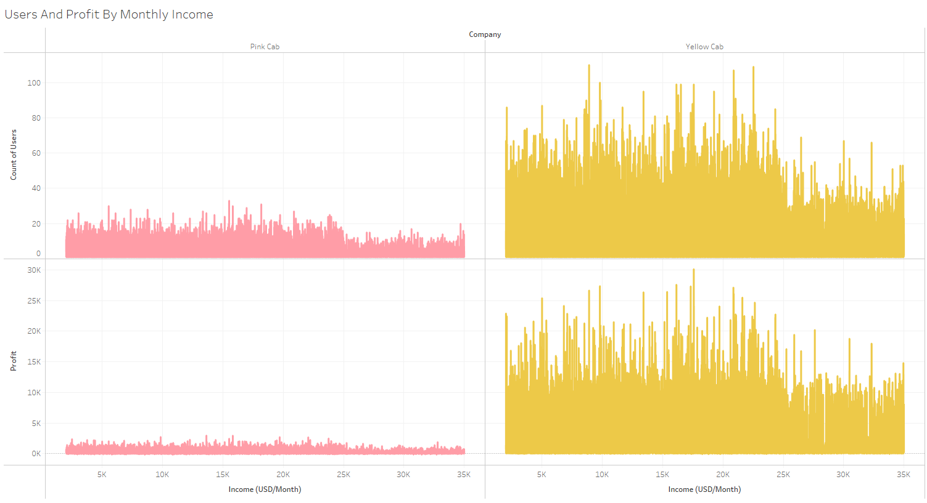
Users And Average Profit Analysis By Monthly Income
Most of the revenue made was between the monthly incomes of $6,700 and $24,000 (middle class). Above and below these values are nearly tied in average profit. Although, monthly incomes above $24,000 generate more total revenue due to more users in this monthly income range. Target cities with a large middle class.

Slide 9
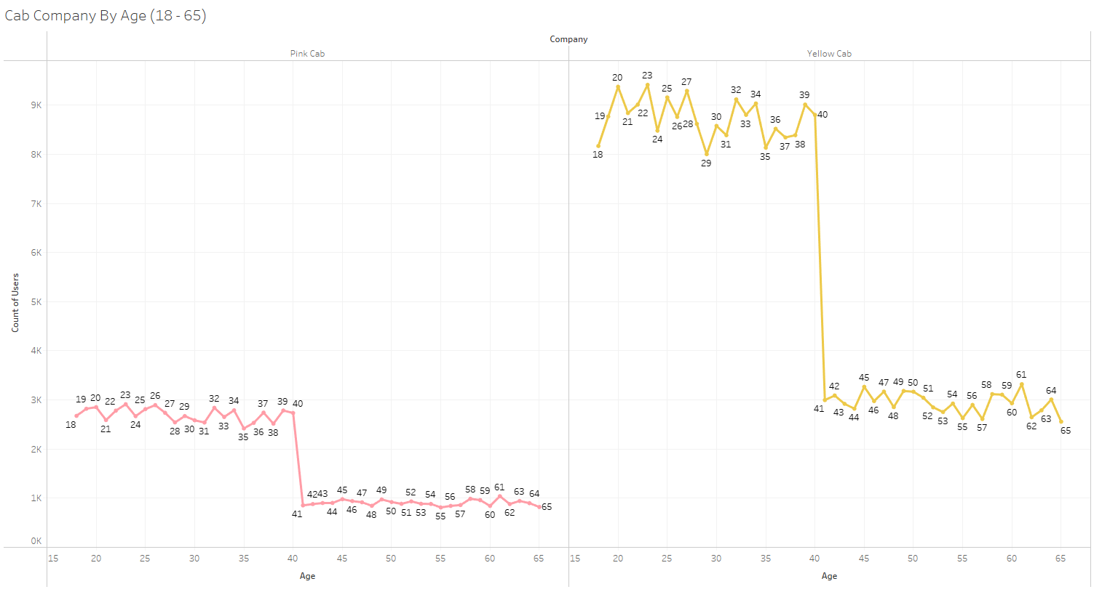
Users Analysis By Age
Both cab companies have a massive drop off in usage once customers enter their 40s, meaning the profit decreases as well. It’s best to target cities with a lower average age of population.

Slide 10
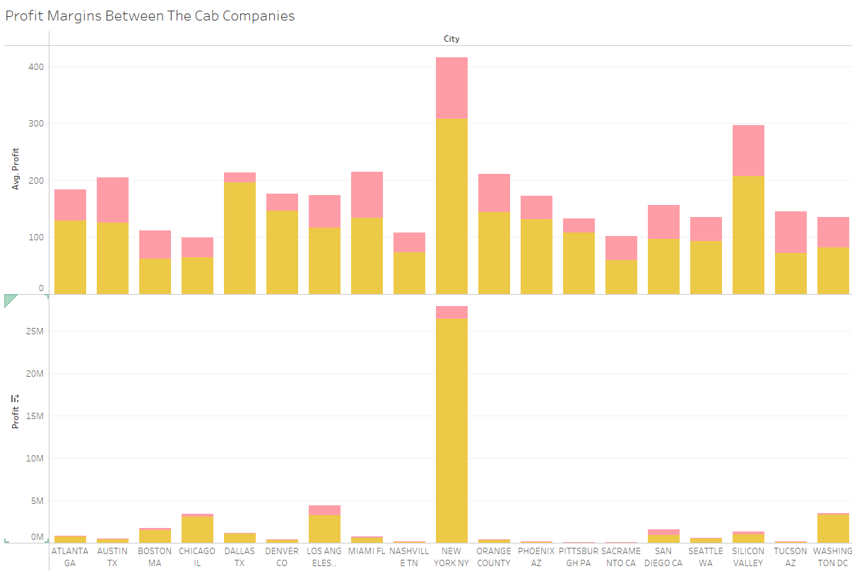

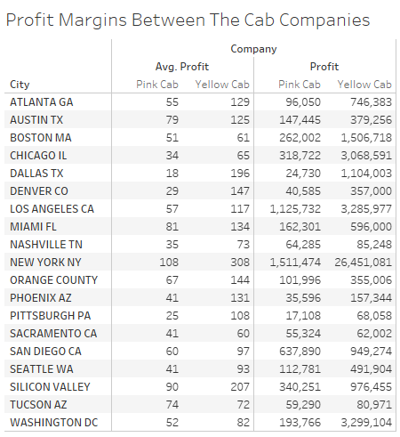
Profit Analysis
Profit Analysis By City

Slide 11
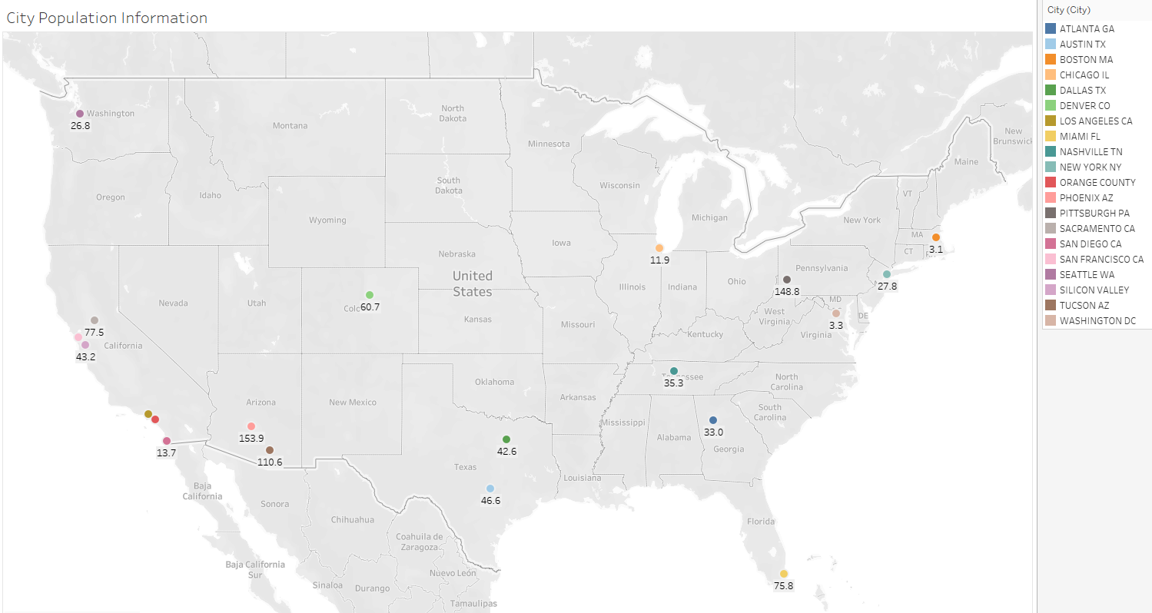
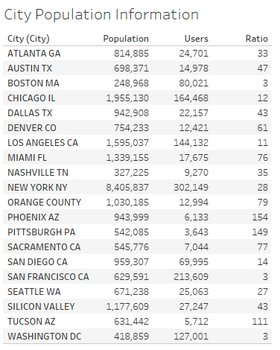
Profit Analysis
Ratio Of Cab Users Analysis By City
3.0
The lower the number, the more of the population in each city that uses cab services (might not be Yellow or Pink Cab). Thus, lower is better, higher is worse.
11.1
79.3

Slide 12
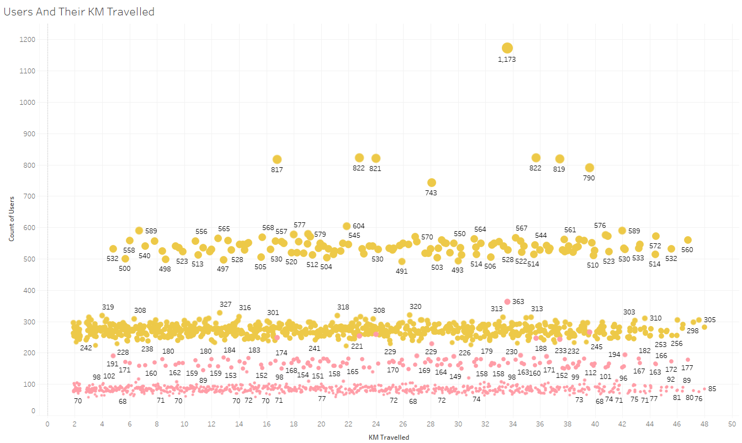
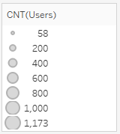

Users And Their Distance Travelled Analysis
The Yellow Cab Company has nearly equal average customers for short, medium and long rides. The Pink Cab Company has equal average customers for medium rides but they fall off on shorter and longer rides. Rides that are 5-40 KM contribute most of each cab company’s users.
On average, there is a difference between the Yellow and Pink Cab Companies in users and KM travelled, the Yellow Cab Company having the higher average in both.

Slide 13
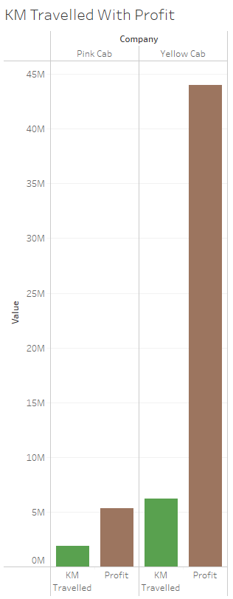
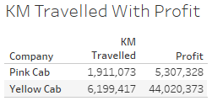
Profit Analysis
Distance Analysis
The Yellow Cab Company has 3x more distance travelled in all their transactions in every city
compared to the Pink Cab Company. This result, along with the greater prices, allows for the Yellow Cab Company to have such a large gap in profit compared to the Pink Cab Company.

Slide 14
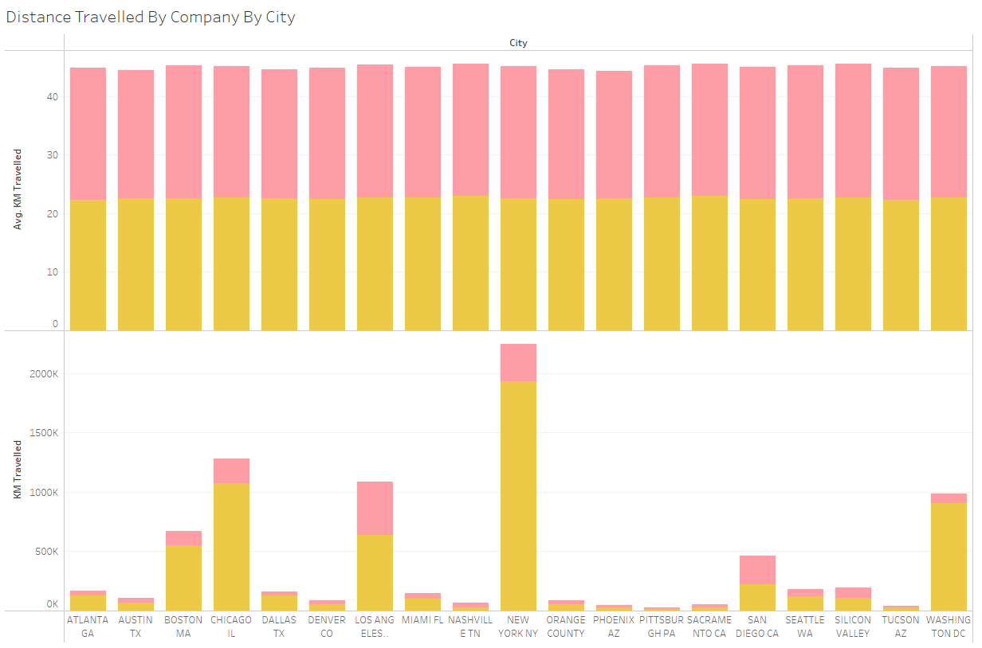
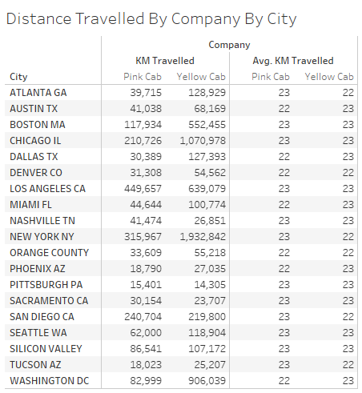

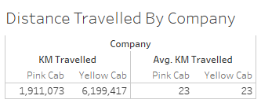
Profit Analysis
Distance Analysis By City
When looking at averages, both companies average about the same distance travelled in each city per ride. However, the Yellow Cab Company has more KM travelled in 15 out of 19 cities.

Slide 15
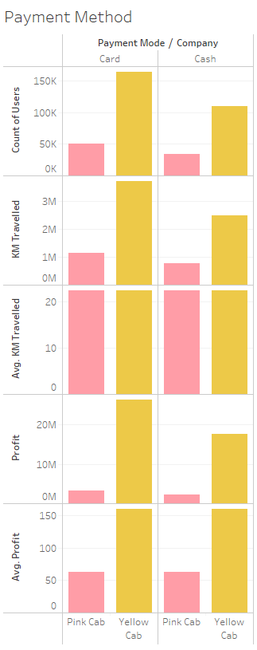
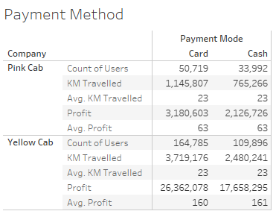
Profit Analysis
Payment Method Analysis By City
On average, customers who pay with cards travel similarly to customers who pay with cash, for both companies. The same could be said about average profit, as the cab companies receive the same relative revenue whether card or cash is used. The only significant finding is that customers use cards statistically significantly more than customers who pay with cash.

Slide 16
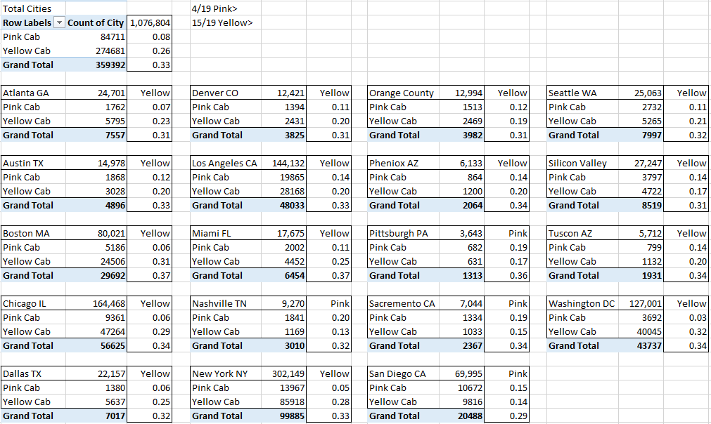
City Covered By Company Analysis
This is the number of users covered by the Yellow and Pink Cab Companies in each city against all cab users in each city. Both companies combine to average about 33% of the service in every city.
The Yellow Cab Company averages about 26% of the share of coverage in every city while the Pink Cab Company only averages about 8% of the share in each city. However, the Pink Cab Company does cover more users in 4 of the 19 cities we are analysing (Nashville, Pittsburgh, Sacramento, and San Diego). This also tells us there is lots of competition in these cities for cab companies.

Slide 17
Recommendations
I have evaluated both the cab companies and found the Yellow Cab Company better than the Pink Cab Company, here is my reasoning:
Total Profits: The Yellow Cab Company earns more than 2.5 times the profit of the Pink Cab Company. In fact, they earn more in 18 out of the 19 cities from the dataset (Tucson AZ, Pink Cab Company earns about $74.20 per trip and the Yellow Cab Company earns about $71.53 per trip). The Yellow Cab Company also projects to earn more than the Pink Cab Company, showing no signs of steep drop off.
Age Matters: The Yellow Cab Company has more customers in all age groups. Despite a big drop off, it’s more popular in the 41+ age group than the Pink Cab Company is in the 18-40 age group. It’s still best to target cities with a lower age of population.
Average Profit per KM: When looking at averages, both companies average about the same distance travelled in each city per ride. However, the Yellow Cab Company has more KM travelled in 15 out of 19 cities. The Yellow Cab Company’s average profit per KM is almost 3 times the average profit per KM of the Pink Cab Company.
Monthly Income Results: The Yellow Cab Company performed better than the Pink Cab Company in offering their services to all three income classes (lower, middle and upper). They had a higher average profit and total profit margin for each income class, and a much higher user count for these three classes. Target cities with a large middle class as that is where most of the profit is generated.
Other Variables: Some features that I researched, like payment method and gender, showed little to no significance to the profit margins of the two cab companies.
As per the point above, I will recommend the Yellow Cab Company for investment.

Slide 18
Thank You

